Slide 1

NSC Hybrid Team

Slide 2

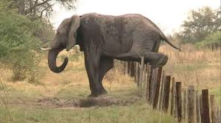
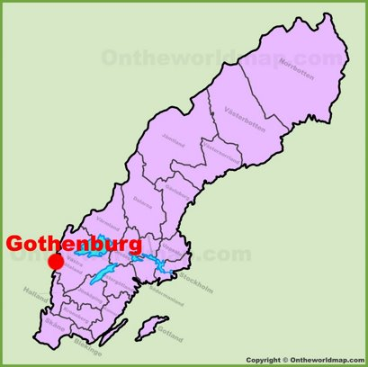

OUR CASE
Hybrid Team
Same challenges with Elephants
Met expert trying to solve same problem

Slide 3


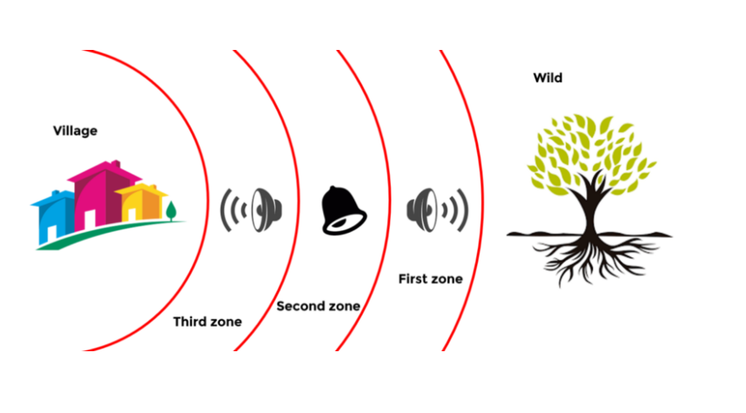
THE ZONES
Zone 1 : Keep elephants in wild – Ex.: send subsonic sound waves
Zone 2 : Escalations messages – Ex.: notify stakeholders, bee-vehicle, different sounds
Zone 3 : Alert humans – Ex.: information & sound alerts, “non-violent get out now”
4Km

Slide 4
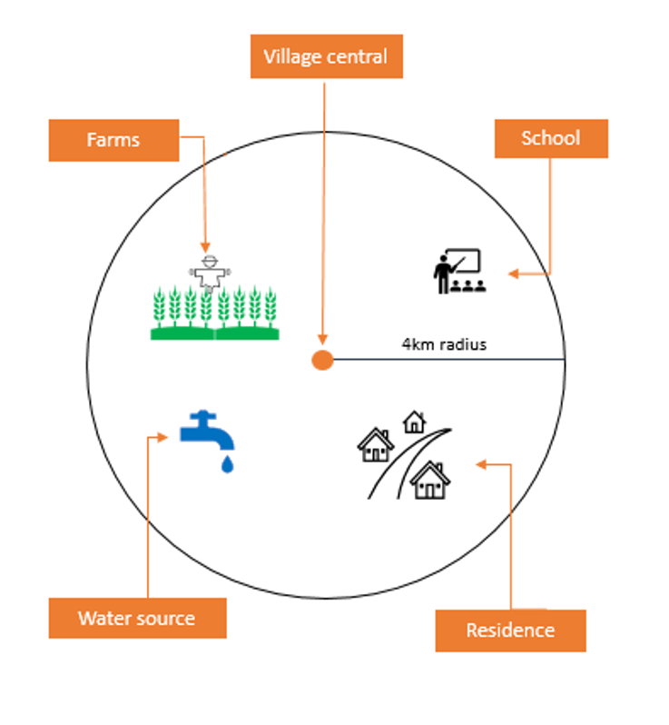
SENSOR PLATFORM
Know elephants’ location / via earth
Trigger proper actions / per zone
Capture images of elephants
4 km radius
30 min heads up alert

Slide 5
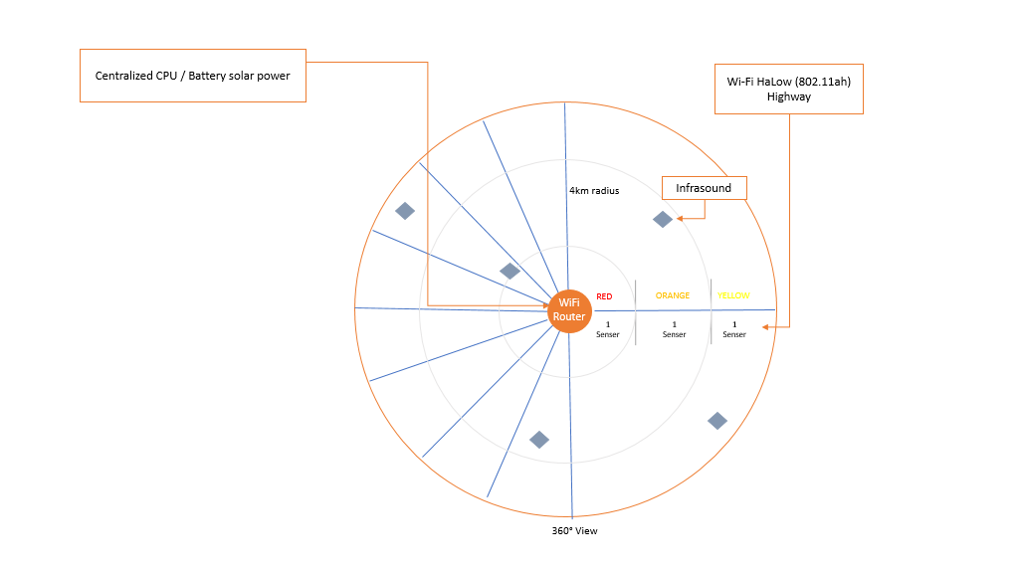
Sensor & Camera
Cost-efficient technology
Detect up to 1 km
Penetrate forest
Communication
No or low internet
Low power

Slide 6
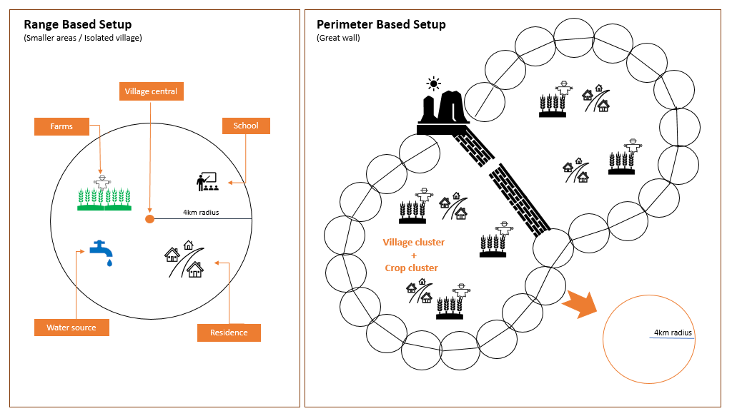

Slide 7





Close connectivity
No or Low Internet
Sensors
Long range IoT Wi-fi router
Alert villagers with no internet
Low power
Low Frequency Noise Sensor & emitter
Image capture using cameras
PLATFORM
Centralized CPU
Audio Devices
Long range IoT Wi-fi router
Elephant sound detection
Notification trigger
Low frequency noise
Alert villagers

Slide 8
Sensors
Low Frequency Noise Sensor will be monitoring the low frequencies emitted by the elephants.
Sensors are able to emit back low frequencies which are capable of chasing the elephants away
If we are going to use the images for image processing, then the cameras would be used for it
Audio Devices
We will be requiring audio devices to general different sounds for the elephants if they do not get chansed away for the low frequency noise. We will have to general noises such as Bee, Vehicle as well as Gunshots
Villagers will have to be alerted with sirens if needed. For which we would be needing audio devices
No or Low Internet
The router we are going to use is going to have a long range with very low power consumption.
We do not need to have internet to communicate with the villagers
The router we are using is made for long range low power usage, where it would be transmitting data which is of very low level in terms of capacity
Centralized CPU
Centralized CPU would be receiving the signals from the sensors, and it would be matching it with the local database which runs the algorithm to make sure this is a frequency generated from the elephant
Triggering the notifications and image processing would also be done by the same CPU

Slide 9
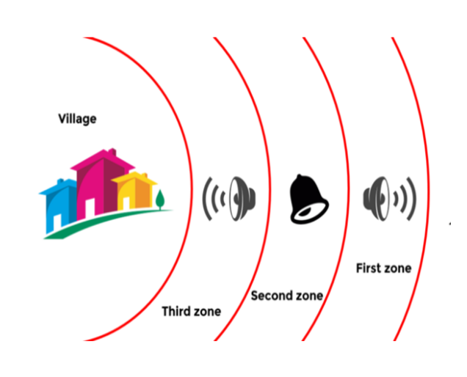
Actions platform
Zone 1
Discover elephant
Listen & match low frequency
Capture images/videos
Trigger low frequency noise to elephants
Update zone status in control SW
LED panels & live dashboards
Zone 2
Alert key resources, stakeholders
Trigger different noises to scare elephants
Alert zone status in control SW
LED panels & live dashboards
Zone 3
SMS alerts to humans
Alert rangers, medical team, animal transporters
Trigger audible sounds to humans

Slide 10
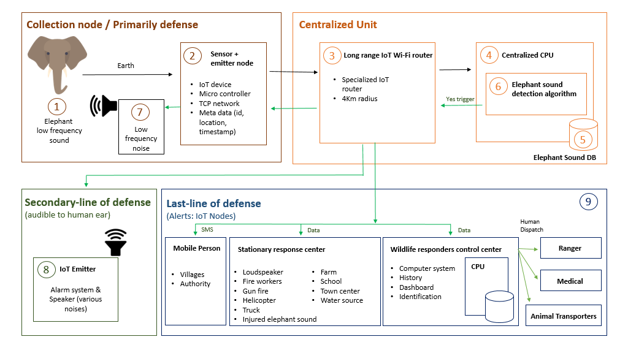

Slide 11
COST ESTIMATE
Total Estimate for 1 system (4 km)
SEK 150,000
Includes: SW Development, Sensor platform devices, Action platform devices
Notes:
Cost estimated based on Project done in Srik Lanka (has expertise and low cost)
SW Development (one-time cost, not per system)

Slide 12
Cost Estimate of a node ---------------------------------- 50 Sensors & Repelling unit 15,000$ IoT Router 1,000$ Storage & CPU Unit 250$ ================Roughly 140,000 SEK
Fixed cost ----------------------------------- Software & Algo Development 60,000$ ================Roughly 500,000 SEK
Assumption 50 villages, and we will apportion the software cost to each of those villages to arrive at an average cost per node. So total cost per node is SEK 150,000

Slide 13
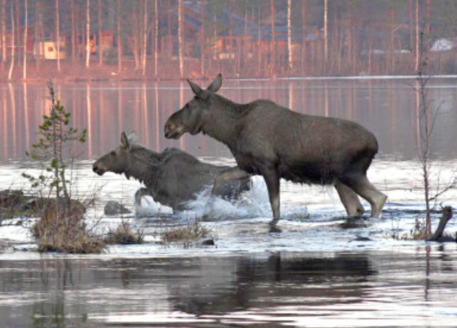
HOW TO FINANCE
Pictures of elephants in the wild / website
Contributing to save elephants and help local community
In Sweden, successful concept with Mousses

Slide 14
THANK YOU!
So EXCITING For US
TO CONTIRBUTIE TO THIS CAUSE!

